Slide 1

Probability Distributions

Slide 2
Objectives
The basic concepts probability and probability distributions
The basic application of probability and probability distributions
Probability Distributions

Slide 3
Normal Distribution
In a normal distribution, data is symmetrically distributed with no skew.
Normal distributions are also called Gaussian distributions or bell curves because of their shape.
Properties of normal distributions
  The mean, median and mode are exactly the same.
  The distribution is symmetric about the mean—half the values fall below the mean and half above the mean.
  The distribution can be described by two values: the mean and the standard deviation.
Probability Distributions
Notes:
In a normal distribution, data is symmetrically distributed with no skew. When plotted on a graph, the data follows a bell shape, with most values clustering around a central region and tapering off as they go further away from the center

Slide 4
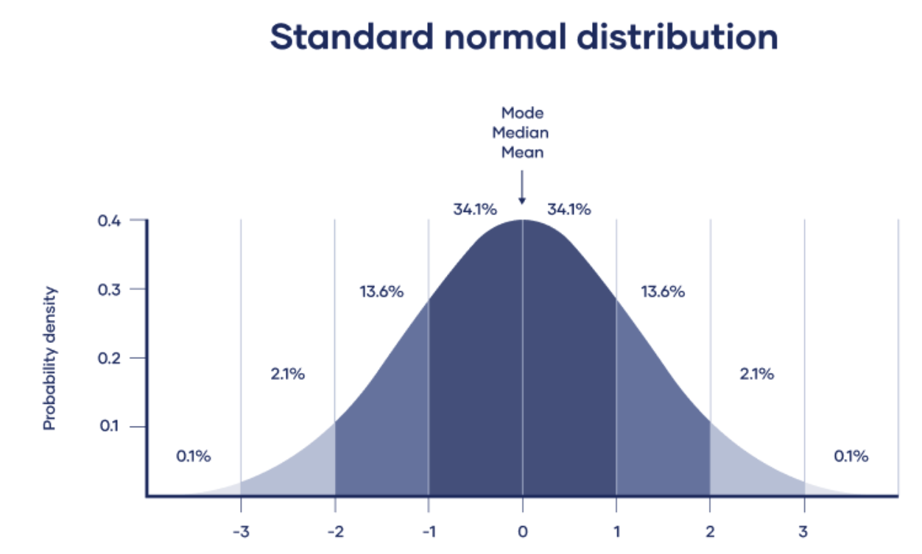
Normal Distribution
Probability Distributions

Slide 5
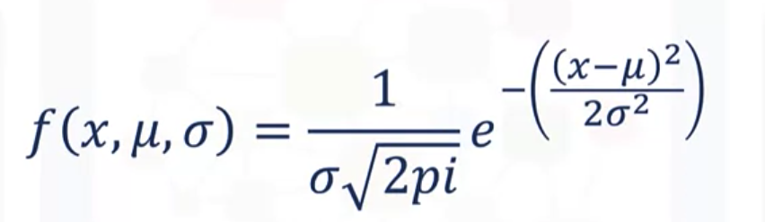
Normal Distribution
Math: We can say that the normal distribution relies on three inputs
  f stands for functions, so function of x, mu and sigma.
  X is your data, x is a random variable and it can attain any reasonable value.
  Mu stands for the mean.
  Sigma is standard deviation.
  pi is 3.142
Probability Distributions

Slide 6
The Standard Normal
Normally distributed data can be transformed into a standard normal distribution.
Standardizing normally distributed data makes it easier to compare different sets of data.
The standard normal distribution is used for:
  Calculating confidence intervals
  Hypothesis tests
Z-values express how many standard deviations from the mean a value is.
The formula for calculating a Z-value is:
  Z=x−μσ
  x is the value we are standardizing, μ is the mean, and σ is the standard deviation.
Probability Distributions

Slide 7
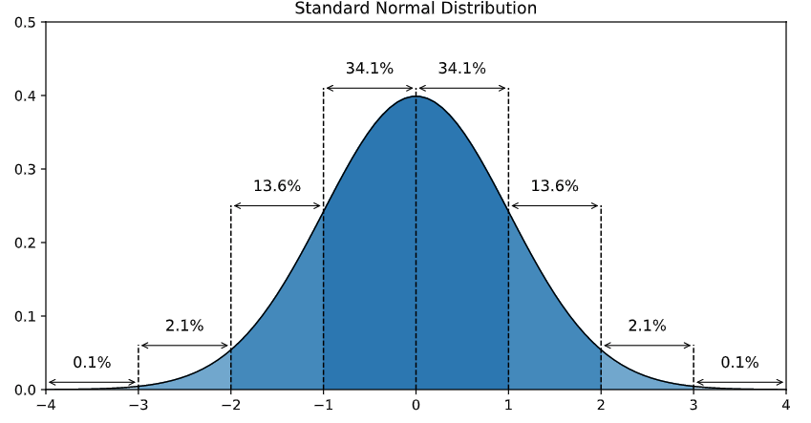
The Standard Normal
Probability Distributions

Slide 8
T- Distribution
The t-distribution is a type of normal distribution that is used for smaller sample sizes. Normally-distributed data form a bell shape when plotted on a graph, with more observations near the mean and fewer observations in the tails.
The t-distribution is used when data are approximately normally distributed, which means the data follow a bell shape but the population variance is unknown.
The variance in a t-distribution is estimated based on the degrees of freedom of the data set (total number of observations minus 1).
Probability Distributions

Slide 9
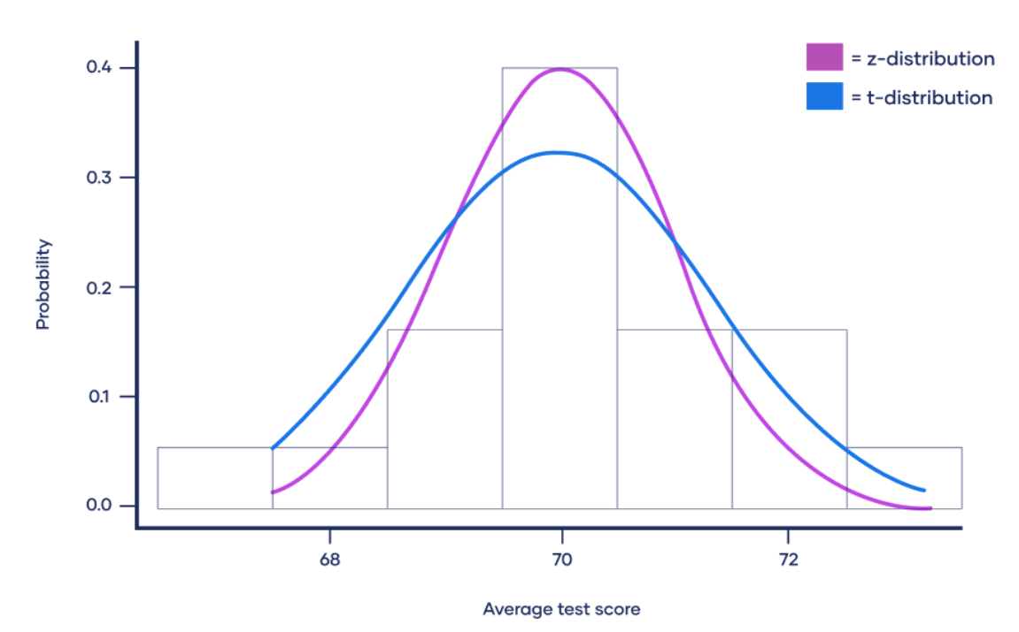
T- Distribution
Probability Distributions

Slide 10
T-distribution and the standard normal distribution
The degrees of freedom increases, the t-distribution will get closer and closer to matching the standard normal distribution, a.k.a. the z-distribution, until they are almost identical.
Above 30 degrees of freedom, the t-distribution roughly matches the z-distribution.
The z-distribution is preferable over the t-distribution when it comes to making statistical estimates because it has a known variance.
Probability Distributions

Slide 11
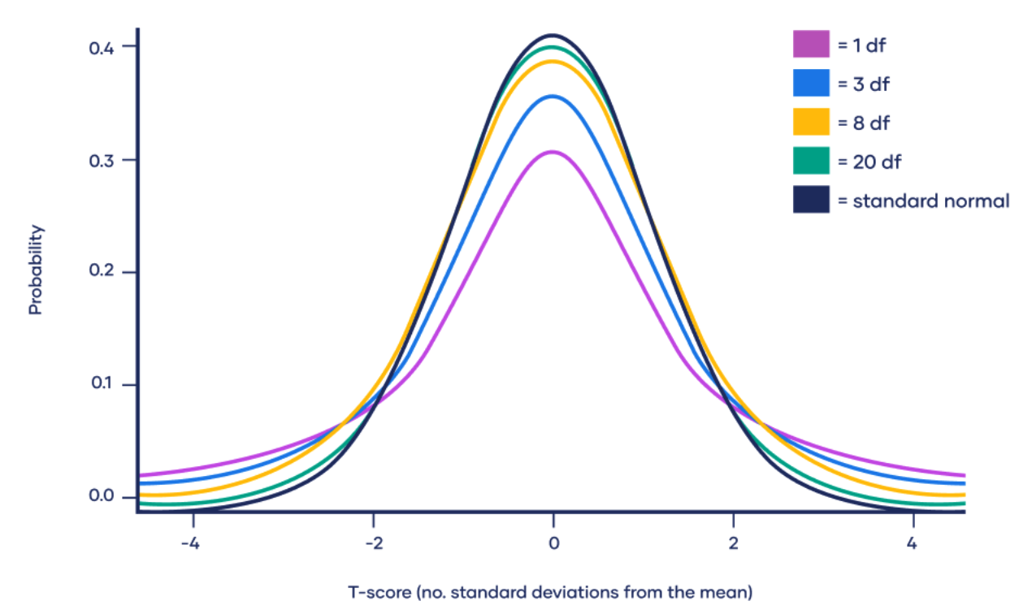
T-distribution and the standard normal distribution
Probability Distributions

Slide 12
Summary
Understand the basic concepts probability and probability distributions
Understand the basic application of probability and probability distributions
Probability Distributions

Slide 13
Q & A
Probability Distributions

